Slide 1
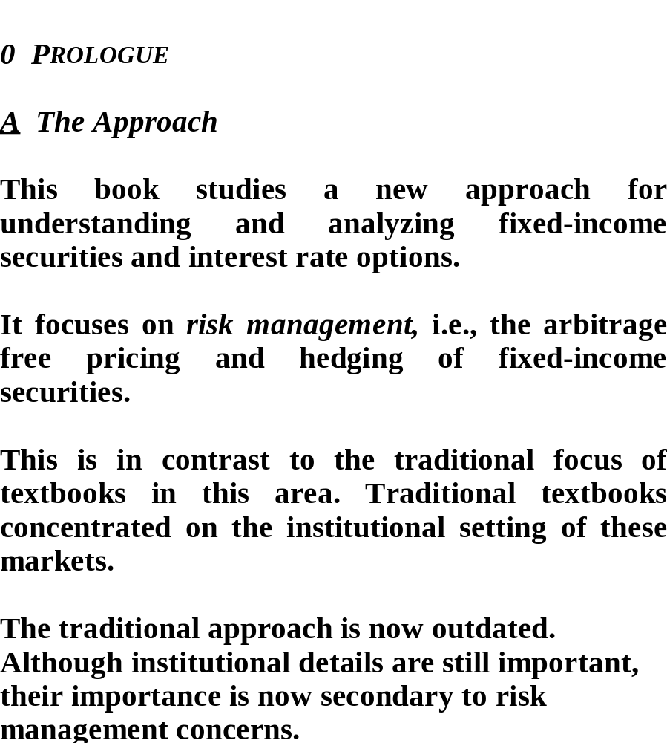

Slide 2
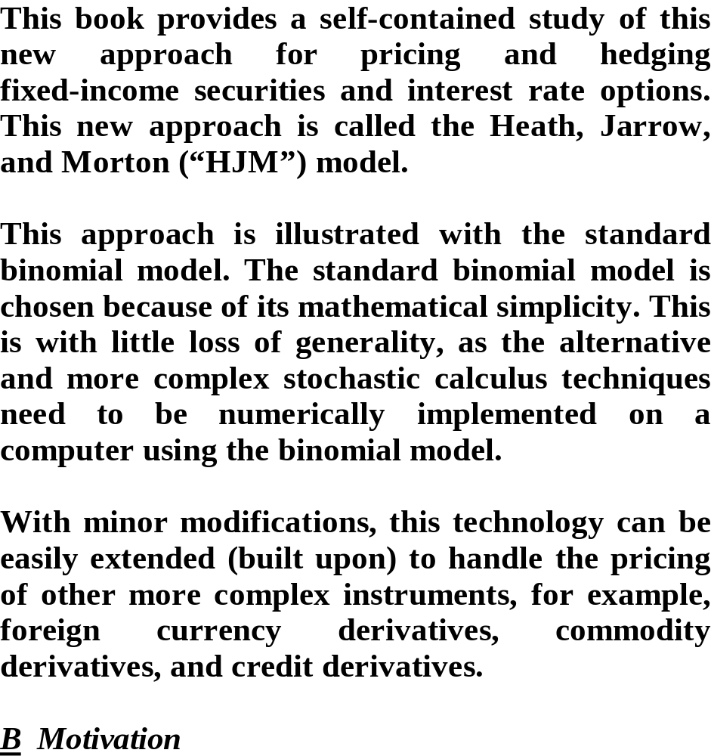

Slide 3
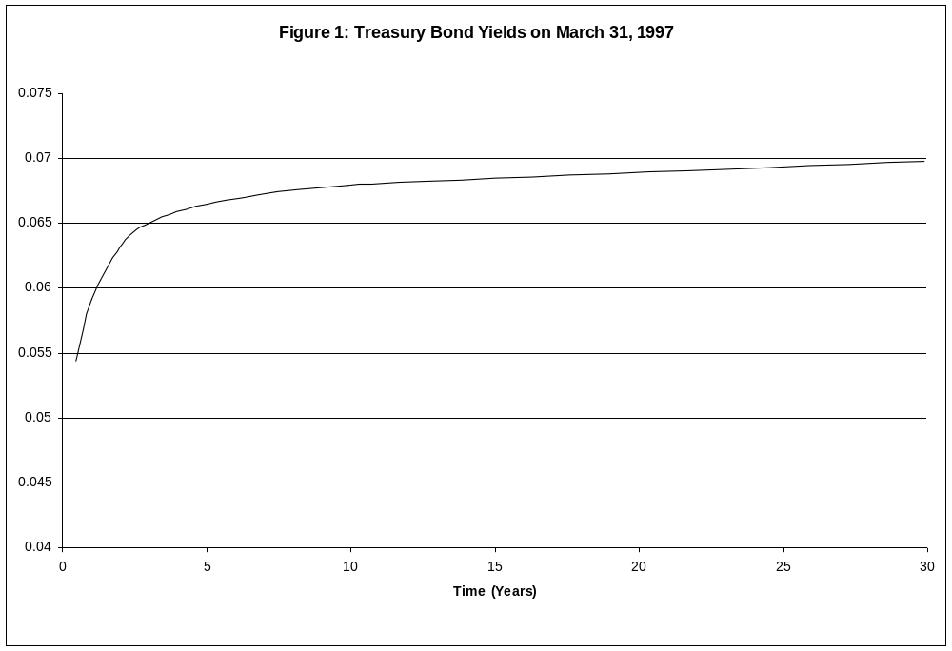

Slide 4
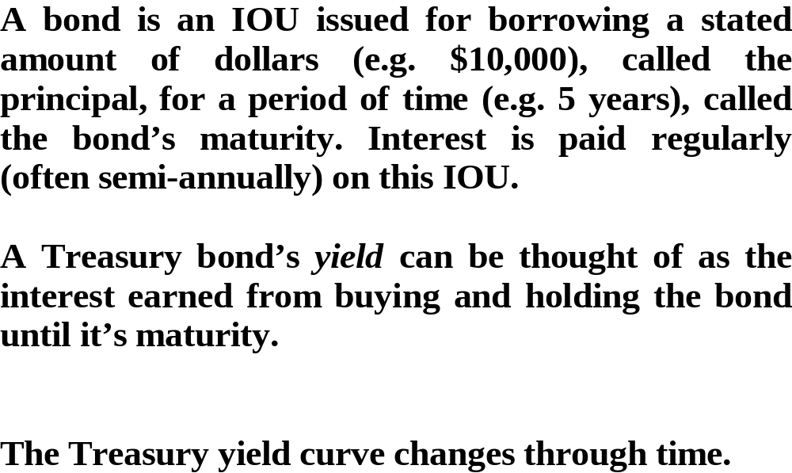

Slide 5
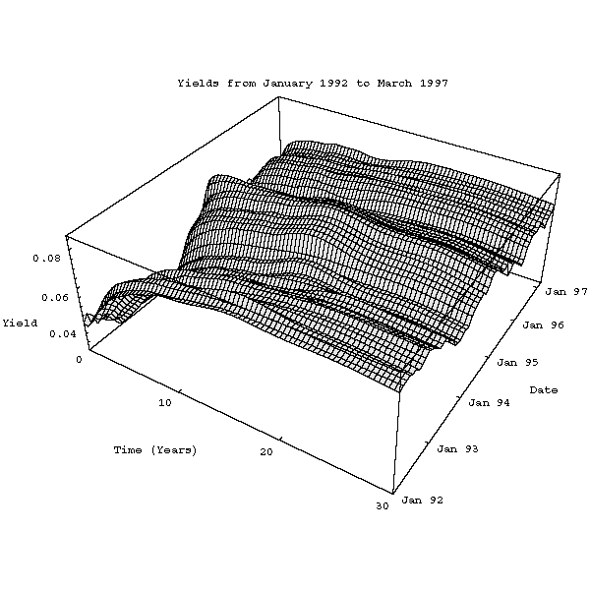

Slide 6
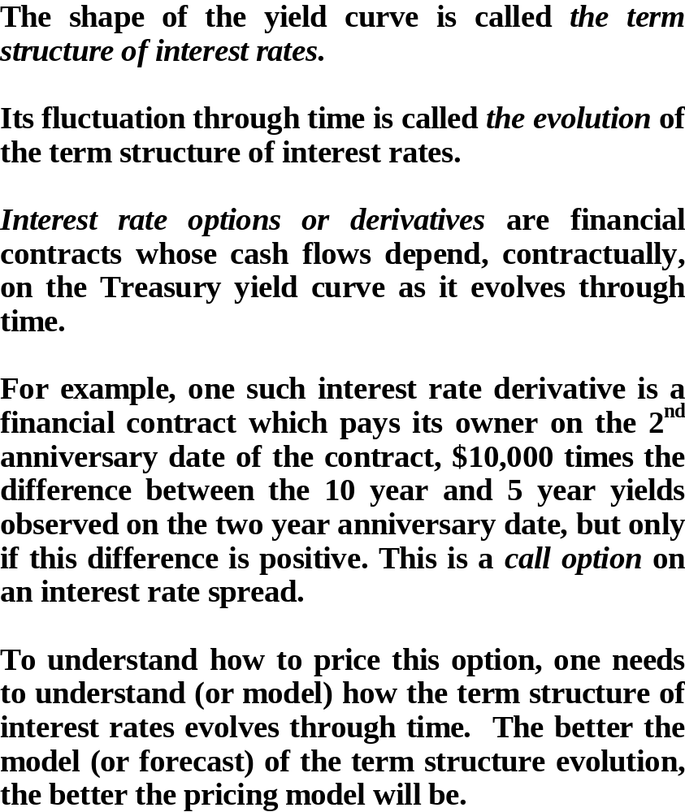

Slide 7
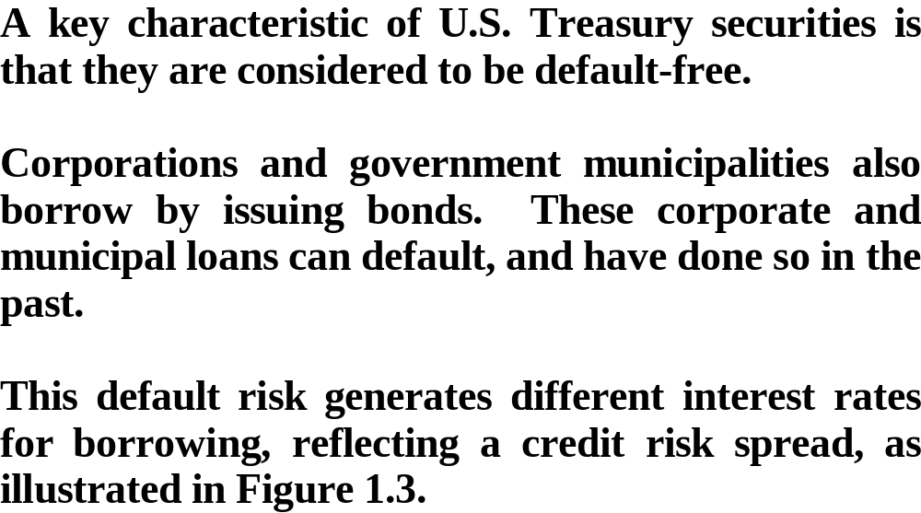

Slide 8
Figure 3: Bond Yields
10.0%
9.0%
←
Corporates
8.0%
7.0%
←
Treasuries
Rates
6.0%
←
Municipals
5.0%
4.0%
3.0%
2.0%
89
90
91
92
93
94
95
96
97
Years

Slide 9
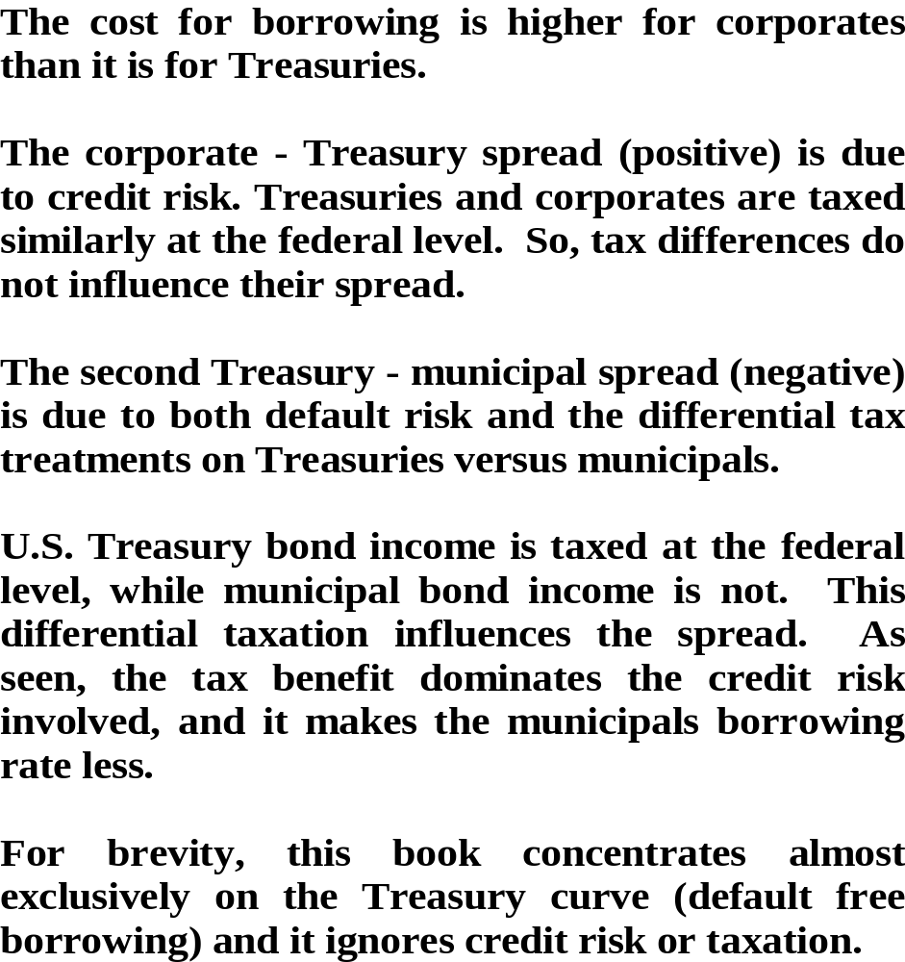

Slide 10
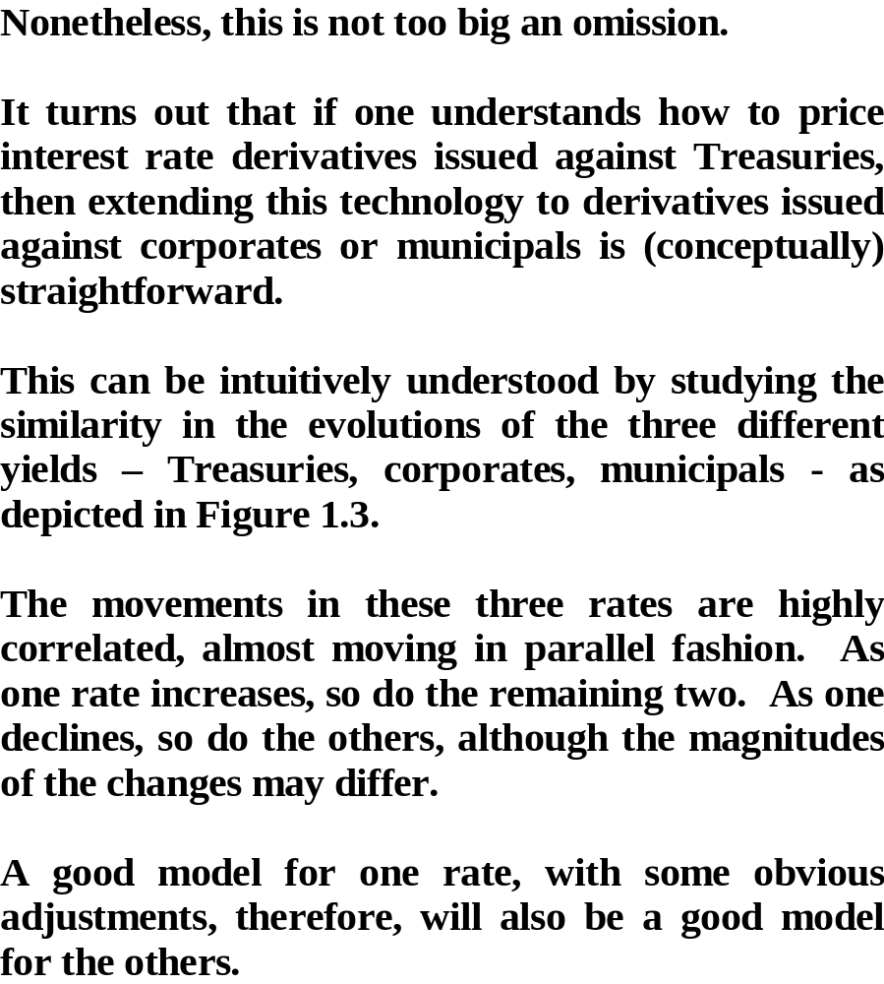

Slide 11
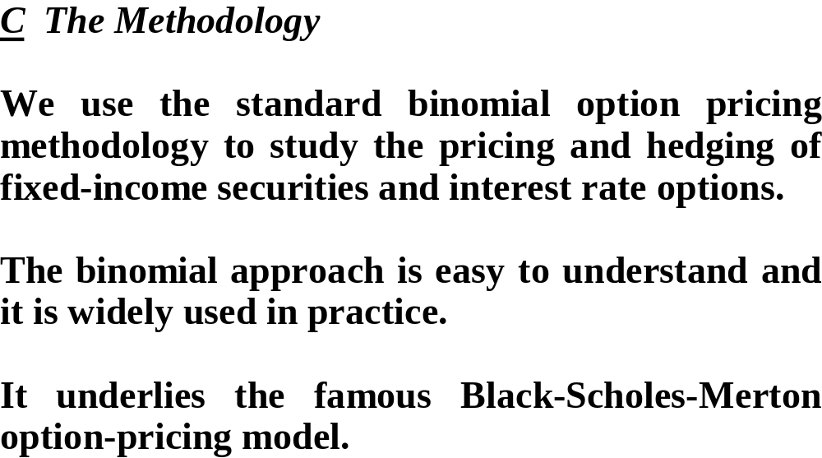

Slide 12
●
branches
●
●
●
●
nodes
●
time 0
●
time 1
time 2
Figure 4: A Binomial Tree

Slide 13
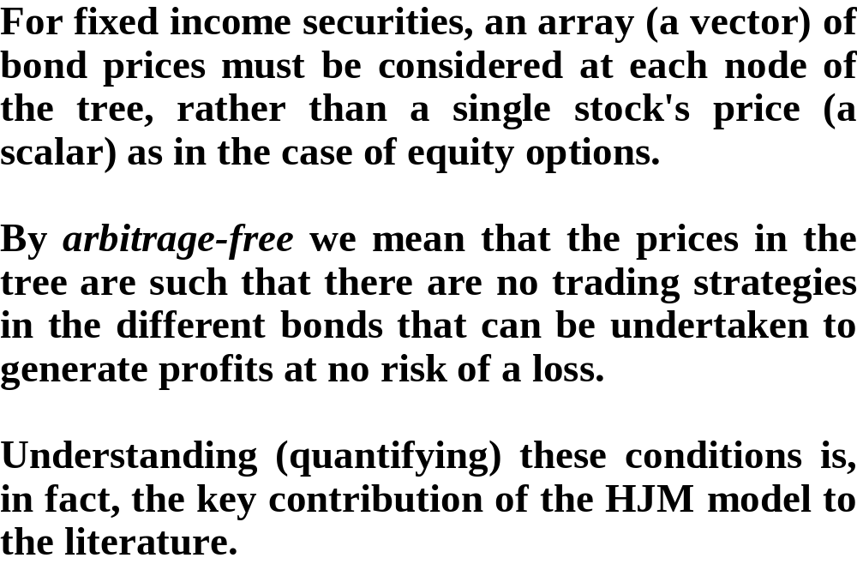

Slide 14
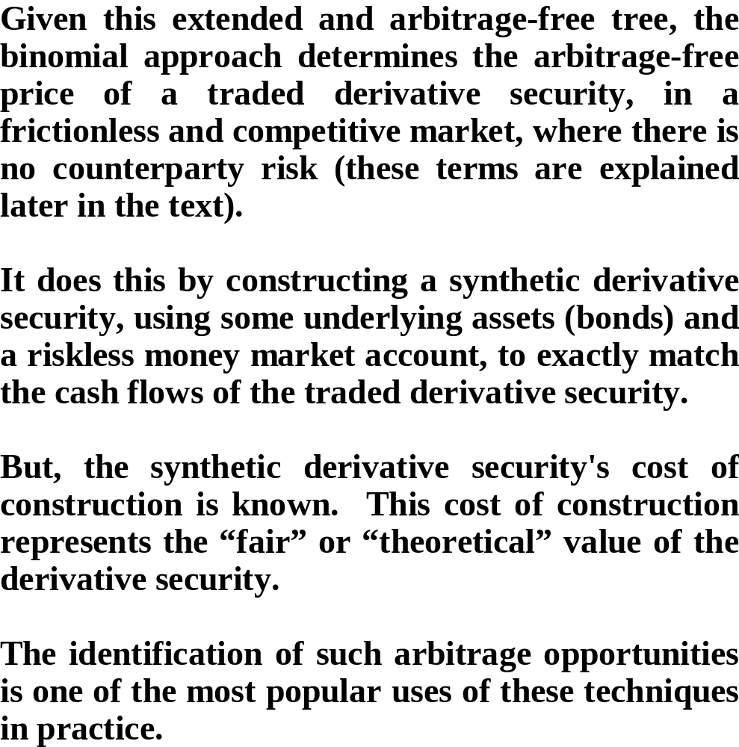

Slide 15
